Slide 1
Asynchronous JavaScript
JavaScript runs code one task at a time
Asynchronous programming allows non-blocking execution
Long-running tasks do not freeze the application
Very important for modern web applications

Slide 2
What is Asynchronous JavaScript
Tasks are executed in the background
Main program continues running
Results are handled once task completes
Used heavily in APIs and servers

Slide 3
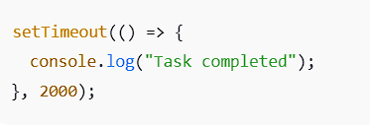
Callback Functions
A callback is a function passed into another function
Called after an asynchronous task finishes
Used in timers, events, and API calls
Helps control execution order
Example:

Slide 4
Callback Hell
Occurs due to multiple nested callbacks
Code becomes hard to read
Debugging becomes difficult
Not recommended for large projects

Slide 5
Promises
Promise is an object representing future completion
Makes async code more manageable
Avoids deep nesting
Supports chaining

Slide 6
Promise Lifecycle
Pending: Promise created but not completed
Fulfilled: Task completed successfully
Rejected: Task failed with an error
Promise state cannot change once settled

Slide 7
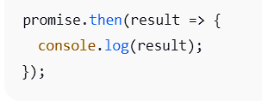
then() Method
Used when promise is fulfilled
Receives the result
Can return another promise
Example:

Slide 8
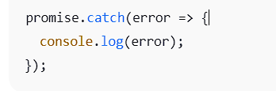
catch() Method
Used to handle errors
Catches rejected promises
Prevents application crash
Example:

Slide 9
finally() Method
Executes in both success and failure
Used for cleanup operations
Does not receive result or error

Slide 10
Promise Chaining
Multiple then() methods can be linked
Output of one becomes input of next
Improves code readability

Slide 11
Promise.all()
Executes multiple promises together
Resolves when all promises succeed
Rejects if any promise fails
Useful for parallel tasks

Slide 12
Promise.race()
Resolves with the first completed promise
Ignores remaining promises
Useful for timeout handling

Slide 13
async and await
Modern way to write async code
Looks like synchronous code
await pauses execution until resolved
Used with promises

Slide 14
Fetch API
Used to make HTTP requests
Returns a promise
Commonly used to fetch JSON data
Replaces older AJAX methods

Slide 15
AJAX Basics
Stands for Asynchronous JavaScript and XML
Used to update web pages without reload
Works with APIs and servers
Improves user experience

Slide 16
Event Loop
Manages asynchronous operations
Executes callbacks after main code
Works with call stack and task queue
Core concept of JavaScript

Slide 17
Concurrency Model
JavaScript is single-threaded
Uses event loop for concurrency
Handles multiple tasks efficiently
Avoids blocking behavior

Slide 18
Conclusion
Async JavaScript improves performance
Promises and async/await simplify code
Event loop manages execution flow
Essential for modern web development

